Slide 1

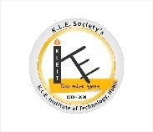
K. L. E. SOCIETY’S
K. L. E. INSTITUTE OF TECHNOLOGY,
Opp. Airport, Gokul, Hubballi-580 027
Phone: 0836-2232681 Website: www.kleit.ac.in
“ Prediction of Daily Reference Evapotranspiration Using
Machine Learning Model ”
Bachelor of Engineering in Computer Science and Engineering
(18CSP83)
Academic Year 2023-24
Submitted By
Ms. Pooja A Wadekar 2KE20CS052
Ms. Pooja P Belgaumkar 2KE20CS054
Ms. Vaishnavi Dubey 2KE20CS113
Mr. K D Sandeep 2KE20CS121
Under the Guidance of
Prof. Malathi S.Y

Slide 2

Machine Learning On Evapotranspiration
CONTENTS
Introduction
Problem Definition
Objectives
Literature Survey
Design
Requirement Specification
Status of Project Implementation
Conclusion
References

Slide 3
Machine Learning On Evapotranspiration
INTRODUCTION
Evapotranspiration (ET) is a process which includes loss of water from the plant as well as soil surface into the environment.
The process by which water is transferred from the land to the atmosphere by evaporation from the soil and other surfaces and by transpiration from plants is known as evapotranspiration.
Evaporation parameters are being used in studying water balances, water resource management, and irrigation system design and for estimating plant growth and height as well.
The major attributes considered in this evapotranspiration model requires solar radiation, the maximum and minimum air temperature, relative humidity, and wind speed.
Machine learning models can be applied at various spatial and temporal scales, making them adaptable to different applications by calculating the ET value of the plants.

Slide 4
Machine Learning On Evapotranspiration
PROBLEM DEFINITION
Given relevant meteorological and environmental data, the goal is to predict the rate of evapotranspiration (ET) by certain factors of a location.
Evapotranspiration can be influenced by factors such as temperature, humidity, wind speed, solar radiation, soil type, vegetation cover, and more. The objective is to develop a machine learning model that can make accurate predictions of ET, enabling better water resource management and informed decision-making in various applications.

Slide 5
Machine Learning On Evapotranspiration
OBJECTIVES
To collect and preprocessing data samples.
To identify evapotranspiration rate of the crops.
To evaluate ET value using machine learning models(ANN, KNN, LSTM, Random Forest)
To develop framework for estimating the evapotranspiration of the crops.

Slide 6
Machine Learning On Evapotranspiration
LITERATURE SURVEY
Author | Published in | Methodology | Summary
I.A. Awan et al | 2022 | Penman-Monteith equation using ml models | Estimation of water consumption over agricultural areas
Jitendra Rajput, Dinesh Kumar Vishwakarma | Aimspress, 2022 | Stacking hybridization of ANN with meta-heuristic algorithm | Modelling daily reference evapotranspiration under diverse agro-climatic conditions
Farhadian, Afshin, et al. | Remote Sensing, 2021 | Machine learning technique and remote sensing data | This paper focuses on the spatial estimation of evapotranspiration
Li, Shuang, et al. | Water, 2020 | Long Short-Term Memory (LSTM) | spatiotemporal modeling of evapotranspiration, emphasizing their ability to capture temporal dependencies in the data.

Slide 7
Machine Learning On Evapotranspiration
Zhang, Kai, et al. | Journal of Hydrology, 2018 | hybrid machine learning models | The paper discusses hybrid machine learning models that combine different algorithms, such as Decision Trees, Random Forests, and linear regression, for improved evapotranspiration estimation.
Li, Ming, et al. | Hydrology and Earth System Sciences, 2016 | Data-driven models and ANN | Forecasting evapotranspiration based on historical climate and environmental data.
Hossen, Md. Alamin, et al. | Environmental Monitoring and Assessment, 2020 | Machine learning technique | comprehensive overview of the state-of-the-art in evapotranspiration estimation
Kisi, Ozgur | Water Resources Management, 2019 | Machine learning algorithms | This paper provides an overview of machine learning applications in evapotranspiration modeling

Slide 8
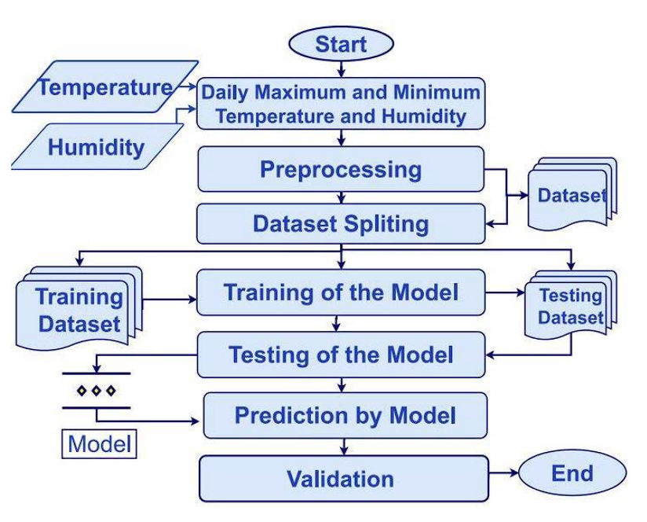
Machine Learning On Evapotranspiration
DESIGN

Slide 9
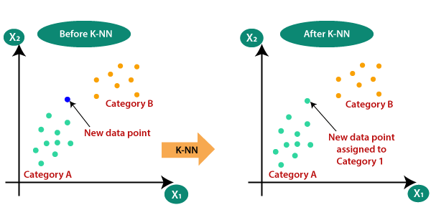
Machine Learning On Evapotranspiration
KNN Algorithm
K-Nearest Neighbors Algorithm, is a non-parametric, supervised learning classifier, which uses proximity to make classifications or predictions about the grouping of an individual data point.
When predicting ET0 for a new day, KNN algorithm identifies the 'k' most similar historical days in terms of their weather features.
The choice of 'k’ and the distance metric used to measure similarity (such as Euclidean distance) are critical parameters influencing the accuracy of predictions.

Slide 10
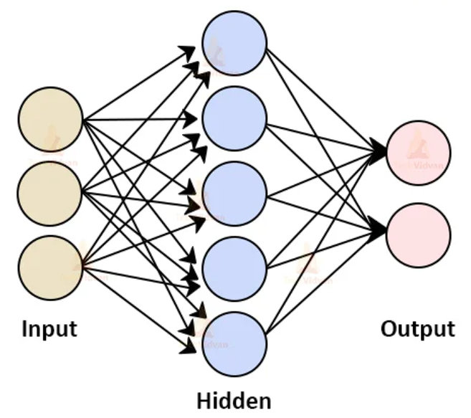
Machine Learning On Evapotranspiration
ANN Algorithm
The ANN consists of layers of interconnected nodes (neurons) where each node performs a weighted sum of its inputs followed by a non-linear activation function.
Through a process called training, the ANN learns to adjust the weights of connections between nodes in order to minimize the prediction error between the predicted and actual daily reference evapotranspiration values.
Once trained, the ANN can effectively predict daily reference evapotranspiration values based on the input weather data.

Slide 11
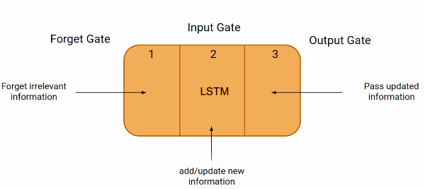
Machine Learning On Evapotranspiration
LSTM Algorithm
Input weather data are fed into the LSTM model, which learns to capture patterns and trends in the data over different time intervals.
The LSTM network contains memory cells that can maintain information over long periods, allowing it to remember past weather conditions and their impact on ET0.
Through training, the LSTM adjusts its internal parameters to minimize the prediction error between the forecasted and actual ET0 values. Once trained, the model can effectively predict daily reference evapotranspiration values based on the sequential weather data.

Slide 12
Machine Learning On Evapotranspiration
REQUIREMENT SPECIFICATION
Input Data: Collect historical weather data including temperature, humidity, wind speed, solar radiation, and any other relevant variables.
Data Preprocessing
Perform data cleaning, normalization, and feature scaling to prepare the data for model training.
Split the dataset into training, validation, and testing sets to evaluate model performance effectively.
Feature Selection: Identify the most relevant features for ET0 prediction through exploratory data analysis and domain knowledge.
Model Selection: Evaluate various machine learning algorithms suitable for time-series forecasting tasks, including but not limited to:
Long Short-Term Memory (LSTM), Random Forest, K-Nearest Neighbors (KNN)

Slide 13
Machine Learning On Evapotranspiration
Model Training: Train the selected machine learning model using the training dataset.
Model Evaluation: Evaluate the trained model using the validation dataset to assess its generalization ability.
Model Deployment: Deploy the trained model into a production environment for real-time ET0 prediction.
Monitoring and Maintenance: Periodically retrain the model using updated weather data to adapt to changing environmental conditions

Slide 14
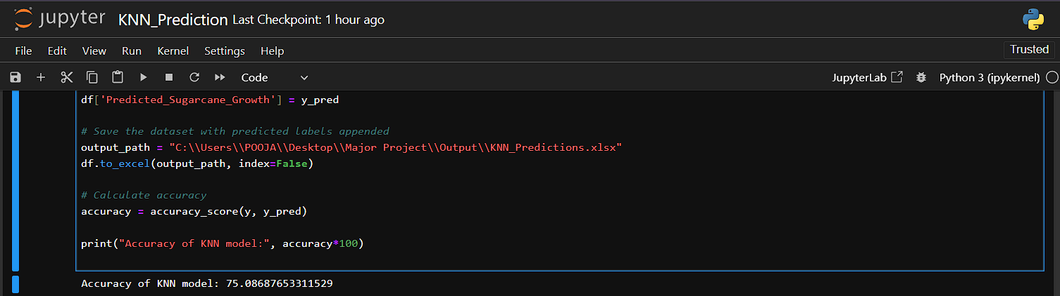
Machine Learning On Evapotranspiration
STATUS OF PROJECT IMPLEMENTATION
1. KNN Model
Accuracy of KNN Model is 75.0868765331 for prediction of daily reference evapotranspiration

Slide 15
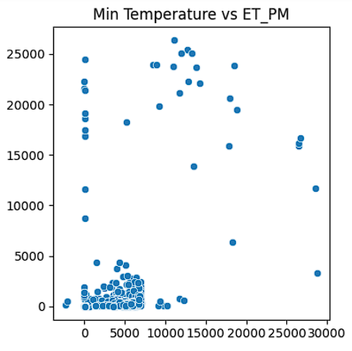
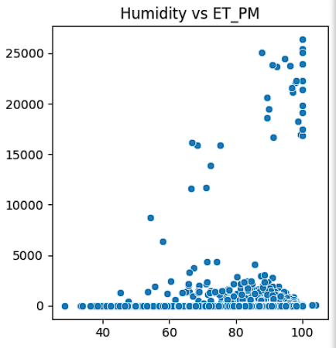
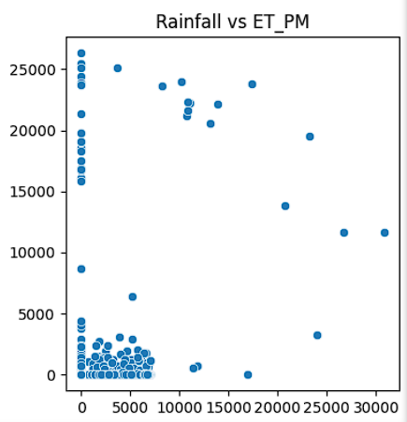
Machine Learning On Evapotranspiration
Graphs: Daily weather references values vs ET value

Slide 16
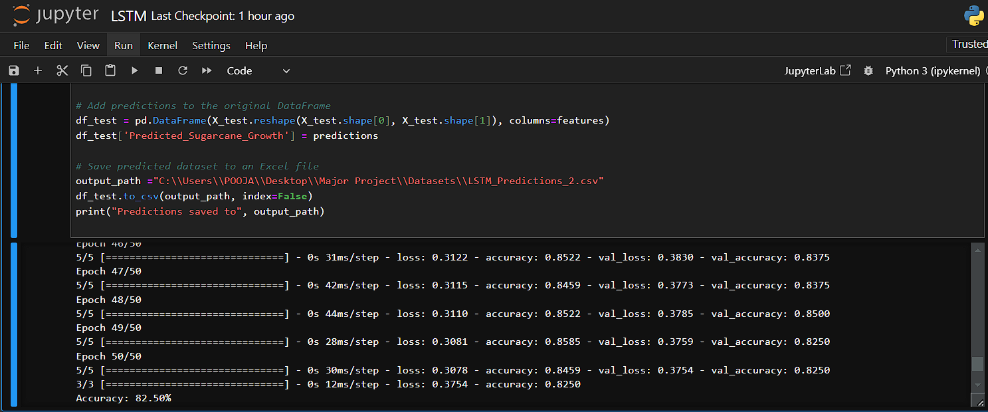
Machine Learning On Evapotranspiration
2. LSTM Model
Accuracy of LSTM Model is 82.50 for prediction of daily reference evapotranspiration

Slide 17
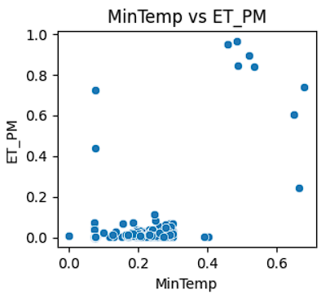
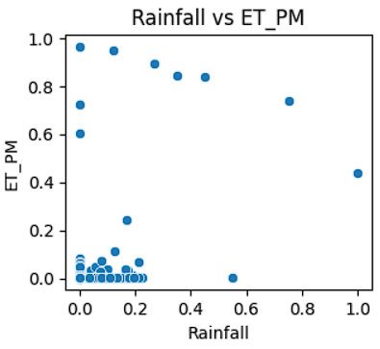
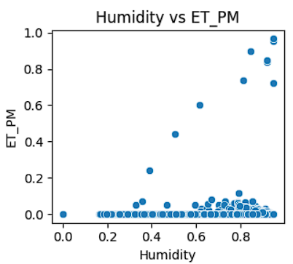
Machine Learning On Evapotranspiration
Graphs: Daily weather references values vs ET value

Slide 18
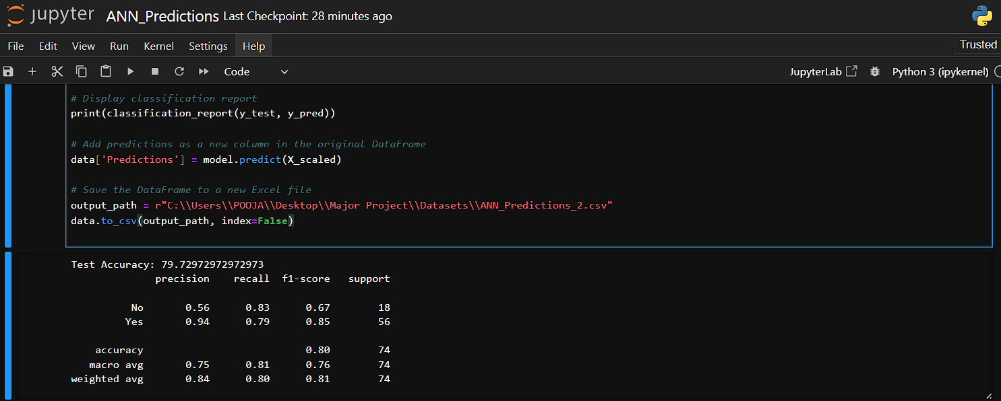
Machine Learning On Evapotranspiration
3. ANN Model
Accuracy of ANN Model is 79.7297 for prediction of daily reference evapotranspiration

Slide 19
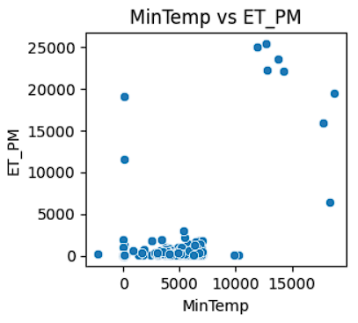
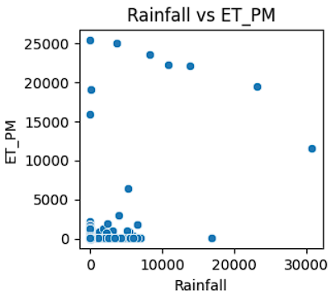
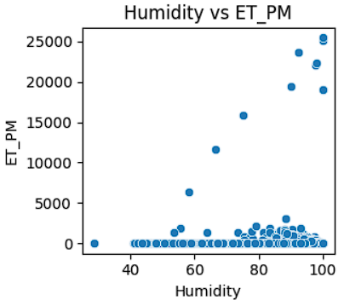
Machine Learning On Evapotranspiration
Graphs: Daily weather references values vs ET value

Slide 20
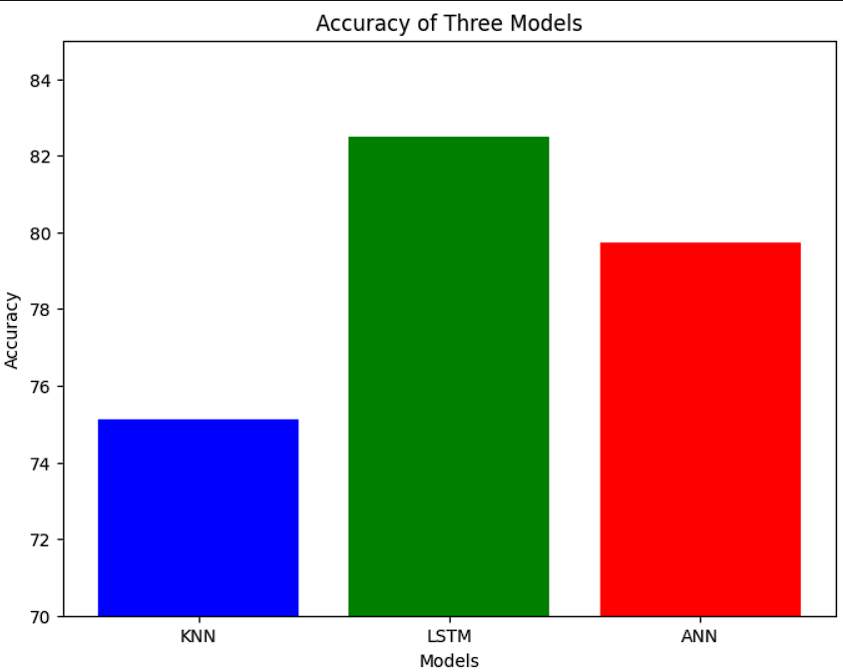
Machine Learning On Evapotranspiration
Accuracy of Three Models

Slide 21
Machine Learning On Evapotranspiration
CONCLUSION
In conclusion, the prediction of daily reference evapotranspiration using machine learning models demonstrates significant potential for improving agricultural water management and irrigation scheduling.
By leveraging advanced algorithms and large datasets, these models can provide accurate and timely estimates, thereby enhancing decision-making processes and promoting sustainable water use.
21

Slide 22
Machine Learning On Evapotranspiration
References
[1] Chen ZJ, Zhu ZC, Jiang H, et al. (2020) Estimating daily reference evapotranspiration based on limited meteorological data using deep learning and classical machine learning methods. J Hydrol 591: 125286. doi: 10.1016/j.jhydrol.2020.125286
[2] Raza A, Shoaib M, Faiz MA, et al. (2020) Comparative Assessment of Reference Evapotranspiration Estimation Using Conventional Method and Machine Learning Algorithms in Four Climatic Regions. Pure Appl Geophys 177: 4479-4508. doi: 10.1007/s00024-020-02473-5
[3] Wu T, Zhang W, Jiao X, et al. (2020) Comparison of five Boosting-based models for estimating daily reference evapotranspiration with limited meteorological variables. Plos One 15: e0235324.
[4] Feng Y, Peng Y, Cui N, et al. (2017) Modeling reference evapotranspiration using extreme learning machine and generalized regression neural network only with temperature data. Comput Electron Agric 136: 71-78. doi: 10.1016/j.compag.2017.01.027
[5] Shiri J (2017) Evaluation of FAO56-PM, empirical, semi-empirical and gene expression programming approaches for estimating daily reference evapotranspiration in hyper-arid regions of Iran. Agric Water Manag 188: 101-114. doi: 10.1016/j.agwat.2017.04.009

Slide 23
Machine Learning On Evapotranspiration
THANK YOU!!

